Slide 1
AKS PRIMALITY TEST
Osho Agyeya(15BCE1326) Shivam Prasad(15BCE1196)
Malladi Tejasvi(15BCE1208)
Shubankar B(15BCE1123) Shivam Pratap Singh(15BCE1053)

Slide 2
Focal points
Significant Aspects
Performance evaluation
Idea;Algorithm;Analysis
Proof of correctness

Slide 3
SIGNIFICANT POINTS:
Invented by Manindra Agrawal,Neeraj Kayal & Nitin Saxena
Unconditional:No constraints involved
Deterministic:Solves the problem with exact decision at every step;no guesses involved;machine’s current state determines what its next state will be; computes a mathematical function which has a unique value for any input in its domain
Polynomial time complexity:Running time is upper bounded by a polynomial expression in the size of the input(no. of digits) for the algorithm

Slide 4
SIEVE OF ERATOSTHENES
2
3
4
5
6
7
8
9
10
11
12
13
14
15
16
17
18
19
20
21
22
23
24
25
26
27
28
In mathematics, the sieve of Eratosthenes, one of a number of prime number sieves, is a simple, ancient algorithm for finding all prime numbers up to any given limit.
It does so by iteratively marking as composite (i.e., not prime) the multiples of each prime, starting with the multiples of 2.

Slide 5
ALGORITHM:
for all numbers m: 2 .. n, if m is unmarked:
add m to primes list;
mark all it's multiples, lesser or equal, than n (k * m ≤ n, k ≥ 2);
otherwise, if m is marked, then it is a composite number.

Slide 6
TIME COMPLEXITY OF SEIVE OF ERATOSTHENES ALGO
Analyzing the time complexity of the above algorithm, for all prime nos Pj<n we cross out a maximum of:
n/2 + n/3 + n/5 + n/7 +…….=n*∑(pj<n)(1/pj)
=n*sum of reciprocals of prime nos <n
If we let S(n) = the sum of the reciprocals of the primes less than n, then for n > 1,
log log n < S(n) < log log n + B + 1/(log n)²
Derived from prime number theorem
So we can say s(n)<log log n
=>ns(n)<n*log logn
=> T(n)=O(nloglogn)
But in the research paper it is given as Ώ(n)
It is also right because s(n)>loglogn
=>n*s(n)>n*loglogn

Slide 7
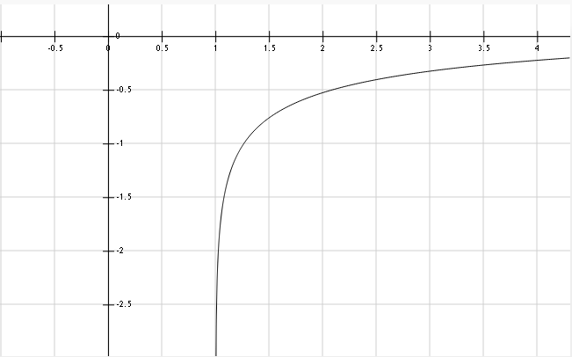
So from graph we get to know that loglogn is always –ve so, ns(n)>=n also
Hence we can prove T(n)= Ώ(n)

Slide 8
FERMAT’S LITTLE THEOREM
If ‘P’ is a prime number and a is a natural number, then
a^{p} ≡ a(mod p)
It is sometimes called Fermat's primality test and is a necessary but not sufficient test for primality.

Slide 9
Proof by mathematical induction:
let a^{p}-a is divisible by p
then lets consider for (a+1)^{p}-(a+1)
from binomial theorem we have (a+1)^{P}= ^{p}C₀.a^{p}.1+ ^{p}C₁.a^{p-1}.1+ ^{p}C₂.a^{p-2}.1+..................+ ^{p}C_{p}.a^{p-p}.1
= a^{p} + ^{p}C₁.a^{p-1}.1+ ^{p}C₂.a^{p-2}.1+..................+1
=>(a+1)^{P}- a^{p}-1= ^{p}C₁.a^{p-1}.1+ ^{p}C₂.a^{p-2}.1+..................
RHS of above equation is divisible by p which automatically means that LHS is also divisible by p
and since (a)^{p}-(a) is divisible by p therefore LHS+(a+1)^{p}-(a+1) is also divisible by p
=> (a+1)^{P}- a^{p}-1+(a)^{p}-(a) is divisible by p
=> (a+1)^{P}-a-1 is divisible By P
=> (a+1)^{P}-(a+1) is divisible by p so in general (a)^{p}-(a) is divisible by p

Slide 10
this means
(a)^{p}=a(mod p)
=>(a)^{p-1}=1(mod p)
which is fermat's little theorem
This is the form of the IDENTITY on which the AKS primality test was built upon:
Clipping from original document shown in the next page…..

Slide 11
Though there were many other versions of primality tests which were more advanced than the sieve of Eratosthenes, like Solovay-Strassen Algorithm, Miller-Rabin Algorithm which were either hypothetically conditional or non-deterministic, Unlike the AKS algorithm which is an unconditional deterministic algorithm……

Slide 12
THE IDEA:
Let a be an integer & n be a natural number such that n>=2,HCF of a & n is 1.Then n is prime iff:
(x+a)^{n} =x^{n} +a (mod n) ,i.e. all the coefficients in ((x+a)^{n} –(x^{n} +a) ) should be perfectly divisible by n.
In other words,^{n}C_{i}*a^{(n-i)} is perfectly divisible by n for 0<i<n.

Slide 13
IMPROVEMENT:
However, this takes Ω(n) because we need to evaluate n coefficients in the LHS in the worst case.To simplify the above condition,we check iff
(x+a)^{n} = (x^{n}+a) (mod x^{r}-1,n),i.e (x+a)^{n} -(x^{n}+a)=nf+g(x^{r}-1) for some polynomials g,f and appropriately chosen small r which is a natural no.

Slide 14
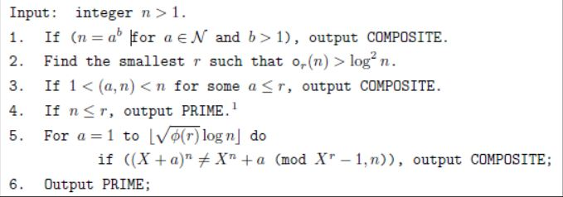
THE ALGORITHM:
In step 2,o_{r}(n) means finding the smallest number k such that n^{k} -1 is divisible by r(r is a natural no).
In step 3,(a,n) represents HCF of a and n.
In step 5, Φ(r) gives the number of numbers less than r that are relatively prime to r. Floor function has been used in the test expression.

Slide 15
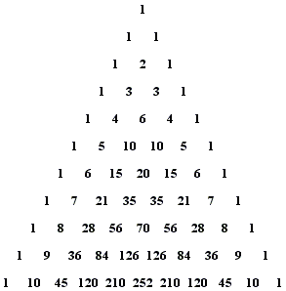
IMPLEMENTATION OF AKS TEST
ALGORITHM-
Generate the row of the Pascal’s triangle corresponding to the no. which needs to be checked for primality.
Leaving the first and the last 1’s, check whether the remaining terms are divisible by the no. or not.
If all the terms are divisible by the number, the number is prime. Else it is composite.

Slide 16
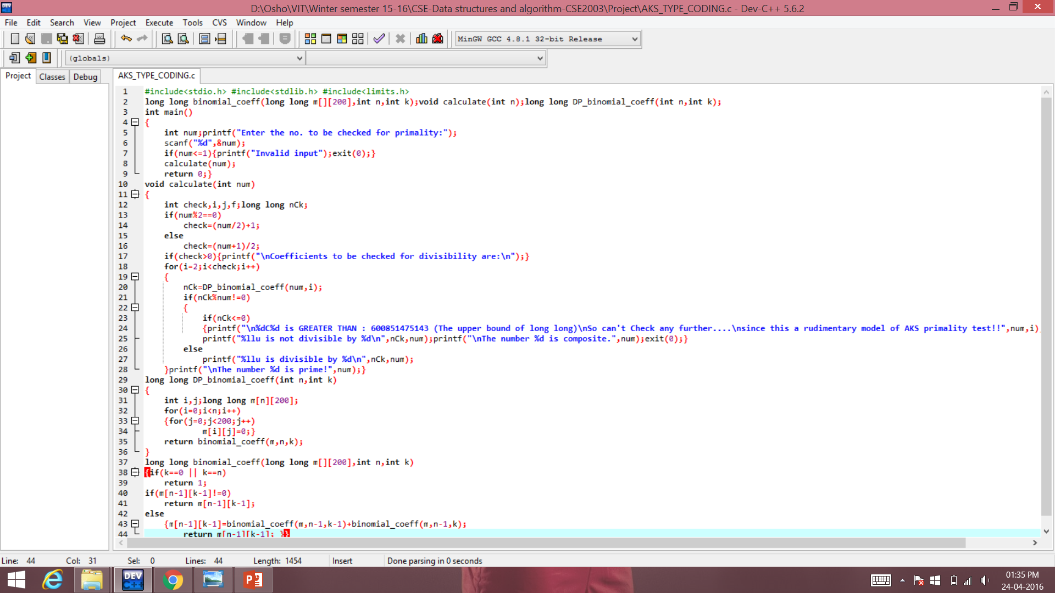

Slide 17
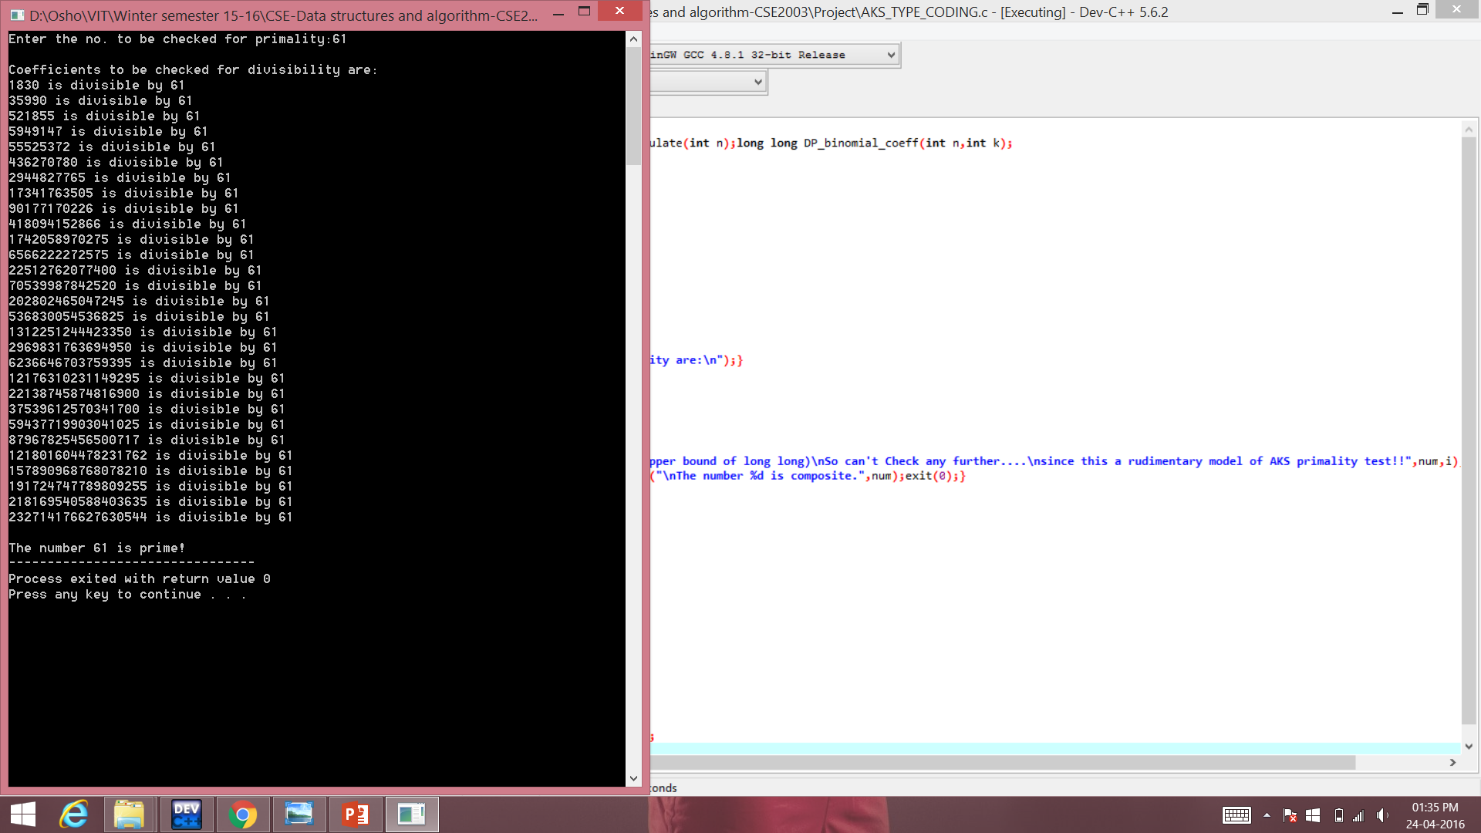

Slide 18
Proof of the identity used
Given proof:” For 0 < i < p, the coefficient of x^i in ((x − a)^p − (x^p − a)) is (−1)^i(pCi)(a^(p−i)) Now if p is prime, pCi ≡ 0(mod p) and hence all the coefficients are zero. ”

Slide 19
Proof explanation
Euclid’s Lemma: If a, b, and c are natural numbers and a divides bc, with a and b having no prime factors in common (a and b are relatively prime), then a divides c.
We know that C( p, i) =p( p − 1)( p −2)……..( p −i +1)/i!
But C( p, i) is an integer and denominator i! divides the numerator. Let a = i!, b = p , and c = ( p −1)( p −2) ( p −r +1) in our statement of Euclid’s Lemma. Since i < p all of the prime factors of i! are less than p. Thus p(b) and i!(a) are relatively prime
Here a divides bc and since and a and b are relatively prime so, by Euclid’s Lemma, a divides c

Slide 20
Proof explanation contd…
“If p is composite: consider a prime q that is a factor of p and let q^k||p. Then q^k does not divide pCq and is coprime to a^(p−q) and hence the coefficient of x^q is not zero (mod p). Thus ((x − a)^p − (x^p − a)) is not identically zero over Fp.”
If q is a prime no and is a factor of p and we are taking q^k to be a factor of p.
pCq=p(p-1)(p-2)…….(p-q+1)/q!
=p(p-1)(p-2)…….(p-q+1)/q(q-1)!
Now we can’t divide pCq by q^k since numerator is already being divided by q so can be divided by q^(k-1) only so we can’t divide by q^k
So for the case i=q coeff. Of x^q not equal to zero(mod p)
So the used identity is correct

Slide 21
IMPROVED EFFICIENCY…
“Thus given a p as input, one could pick a polynomial P (x) = x−a and compute whether the congruence(1) is satisfied or not. However, this takes time Ω(p) because we need to evaluate p coefficients in the LHS in the worst case. Therefore, to make it feasible we will evaluate both sides of (1) modulo a polynomial of the form xr − 1. One iteration of our algorithm will consist of evaluating whether the following holds:
(x − a)^p ≡ (x^p − a)(mod (x^r) − 1, p) (2) “

Slide 22
EXPLANATIONS
The first relation(1) is certainly a valid primality test, it is horribly inefficient as it involves the computation of n coefficients. The trick however is in choosing a suitable integer a. The simplest method for reducing the number of coefficients that need to be computed is to evaluate f(x) modulo n and modulo some polynomial of small degree, say (x^{r} - 1).
(x − a)^p ≡ (x^p − a)(mod (x^r) − 1, p)
which is the same as:(x-a)^{p}-(x^{p} - a)= pf+(x^{r}-1)g,for some polynomials f and g.
It is clear that all primes p satisfy (x + a)^{p} - (x^{p} + a) ≡ 0 mod (p, x^{r} -1), some composite numbers may satisfy this equation for all values of a and r.

Slide 23
Explanation Contd..
It turns out that for a judiciously chosen r, if the above identity is satisfied for several values of a, then n can be shown to be a prime power. The number of a's and the appropriate value of r are bounded by log(n).(It is provable-(using FOURIER MULTIPLICATION) that r need only be logarithmic with respect to n.)
The congruence can be checked in polynomial time with respect to the number of digits in n, because It is provable that r need only be logarithmic with respect to n. The proof of correctness for AKS consists of showing that there exists a suitably small r and suitably small set of integers A such that, if the congruence holds for all such a in A, then n must be prime.

Slide 24
SUITABLE r-value
Our algorithm first chooses a “suitable” r. (An r is “suitable” for us if it is a prime= O (log^6 (p)) and r − 1 contains a prime factor of size at least r ^(1/2 +δ), for some constant δ > 0. [Fou85, BH96] assures us that such a “suitable” r exists.) Thereafter, the algorithm verifies the congruence (2) for a “small” ( O (√r log p) ) number of a’s. We prove that this idea works: i.e. The algorithm correctly determines whether p is prime or not.

Slide 25
EXPLANATION
From the above statements we understand that according to AKS “suitable” r should be a prime such that it is within the bound of O(log^6(p)) and r-1 should have prime factor which are >= r^(0.5+δ) and after finding such an r we can check the congruence-2 for O (√r log p) no. of a’s , which is considered to be a small number.
They have specifically chosen r^(0.5) because an inefficient primality test could also be done by checking for divisibility by each number from 2 t to sqrt(n) so we are choosing an prime greater that sqrt(n)

Slide 26
BASICS AND PRELIMINARIES
“In the rest of the paper Fpd denotes the finite field, where p is a prime. Recall that if p is a prime and h(x) is a polynomial of degree d and irreducible in Fp, then Fp[x]/(h(x)) is a finite field of order pd. In the rest of the paper h(x) will be a factor of x^r −1 unless stated otherwise. x−1
We will use the symbol O˜ (t(n)) for O (t(n)poly(log t(n))), where t(n) is some function of n. Unless stated otherwise, log will be to base 2 in this paper.
We now collect some simple facts from algebra that can be found in any standard text, e.g. [LN86, Fra90]. We also prove some of these for the sake of completeness.”

Slide 27
BASIC CONCEPTS EXPLANATION
RESIDUE: b is the residue in case of a≡b(mod n)
RESIDUE CLASSES: The residue classes of a function f(x)(mod n) are the set of all possible values of the residue of f(x)(mod n) where x ɛ (0,n-1)
A finite field is a field with a finite field order (i.e., number of elements). The order of a finite field is always a prime or a power of a prime. For each prime power, there exists exactly one finite field GF(p^n), often written as in current usage as Fp^n.
GF(p) is called the prime field of order p, and is the field of residue classes modulo , where the elements are denoted 0, 1, ...p-1, . a=b in GF(p) means the same as a≡b(mod p)

Slide 28
BASICS EXPLANATION CONTD…
A polynomial is said to be irreducible if it cannot be factored into nontrivial polynomials over the same field.
For example, in the field of rational polynomials Q(x) (i.e., polynomials f(x) with rational coefficients), is said to be irreducible if there do not exist two non-constant polynomials g(x),h(x) and in with rational coefficients such that : f(x)=g(x)h(x)

Slide 29
BASICS EXPLANATION CONTD…
AKS have taken h(x) will be a factor of x^r −1/(x-1) unless stated otherwise. Which means h(x) is a factor of a G.P with 1st term 1 and common factor x:
1+x+x^2+x^3+.......+x^r
Above proofs are sufficient for proving AKS primality test.
Using some of the ideas which have been developed by us,we may decrease the time complexity of the algorithm and decrease the code length.

Slide 30
Time Complexity
An algorithm is said to be solvable in polynomial time if the number of steps required to complete the algorithm for a given input is O(n^k) for some nonnegative integer k, where n is the complexity of the input.
Polynomial-time algorithms are said to be "fast."
In the first version of the above-cited paper, the authors proved the asymptotic time complexity of the algorithm to be O(log(n)^12) .In other words, the algorithm takes less time than the twelfth power of the number of digits in n for primality check.
In 2005, Carl Pomerance and H. W. Lenstra, Jr. demonstrated a variant of AKS that runs in
O(log(n)^6) operations, where n is the number to be tested - a marked improvement over
the initial bound.

Slide 31
Thank You!!!

